Slide 1
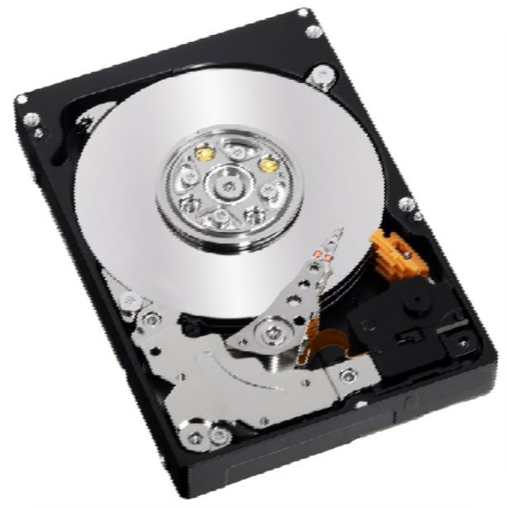

Topic
Hard Disk Drive ( Internal )

Slide 2
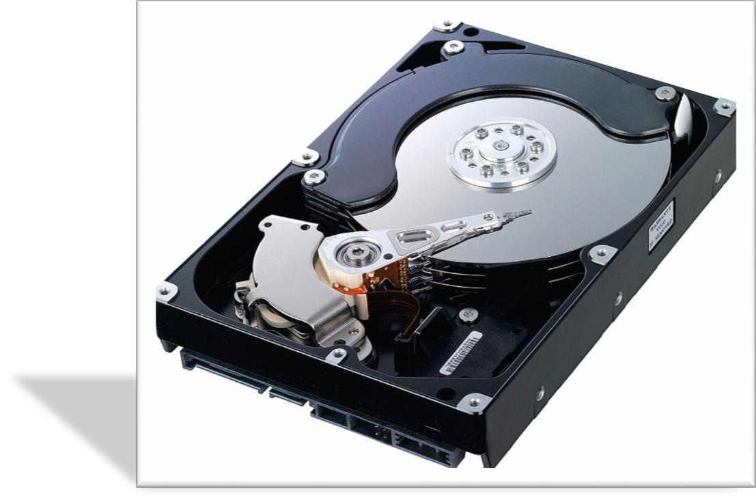
What Is Hard Disk ?
A hard disk drive (HDD) is a data storage device used for storing and retrieving digital information using rapidly rotating disks ( platters ) coated with magnetic material.
An HDD retains its data even when powered off. Data is read in a random-access manner, meaning
individual blocks of data can be stored or retrieved in any
order rather than sequentially.

Slide 3
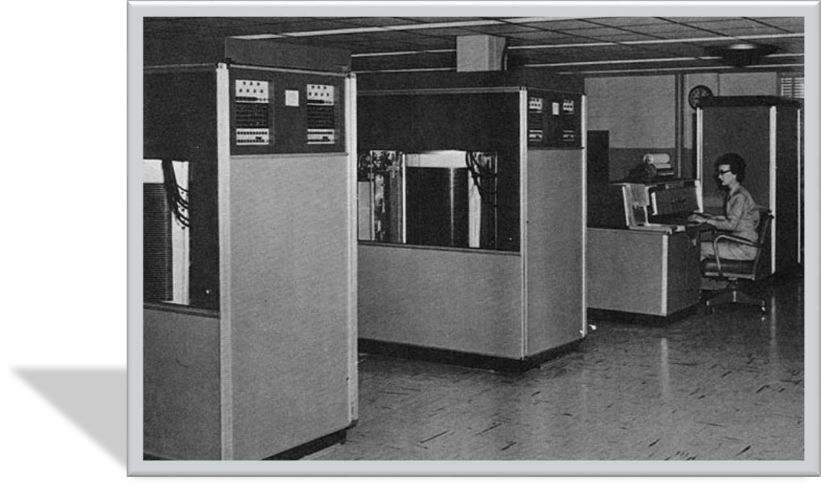
History
HDDs were introduced in 1956 as data storage for an IBM real-time transaction processing computer and were developed for use with general
purpose mainframe and minicomputers.
The first IBM drive, the 350 RAMAC, was approximately the size of two refrigerators and stored 5 million 6-bit characters (the equivalent of 3.75 million 8-bit bytes or 3.75 MB
or megabytes) on a stack of 50 disks.

Slide 4
Technology
Magnetic recording
An HDD records data by magnetizing a thin film of ferromagnetic material on a disk. Sequential changes in the direction of magnetization represent binary data bits.
The data is read from the disk by detecting the transitions in magnetization.
User data is encoded using an encoding scheme, such as run-length limited encoding, which determines how the data is represented by the magnetic transitions.

Slide 5
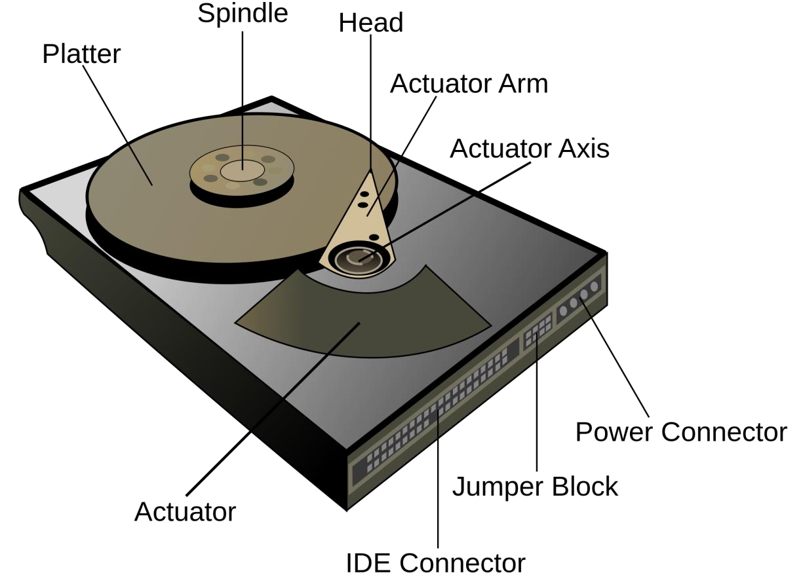
Components
A typical HDD has two electric motors, a spindle motor that spins the disks and an actuator (motor) that positions the read/write head assembly across the spinning disks.
The disk motor has an external rotor attached to the disks; the stator windings are fixed in place. Opposite the actuator at the end of the head support arm is the read- write head.

Slide 6
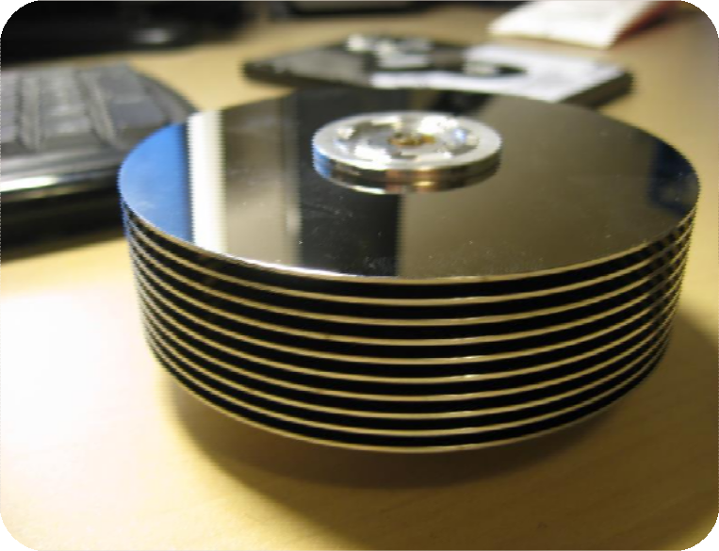

Platters
A typical HDD design consists of
a spindle that holds flat circular disks, also called platters, which hold the recorded data. The platters are made from aluminium alloy, glass, or ceramic, and are coated with a shallow layer of magnetic material typically 10–20 nm in depth, with an outer layer of carbon for protection

Slide 7
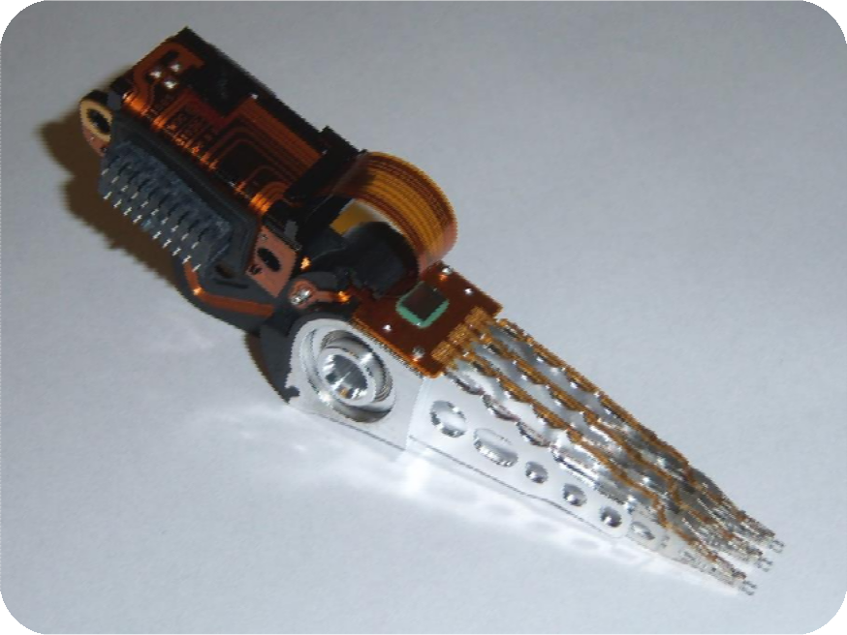

Read/Write Head
Read/Write head Is used for read/write data in magnetic Form

Slide 8

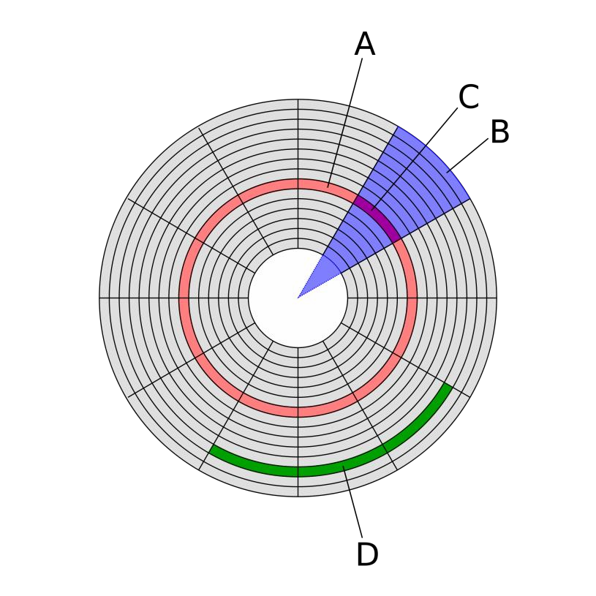
Platter’s Structure
Track
The HDD is divided into number of concentric circlues called
tracks.
Circular path in sector is called track.
Sector
Data storage area in one track multiple divided into the multiple block is called sector.
Each sector can have 512 bytes of the data.
Cylinder
A set of corresponding tracks in all sides of a hard disk is called cylinder.
Storage Capacity
cylinders x heads x sectors x 512 bytes = () /1024 to convert to kilobytes =() /1024 to convert to megabytes
10

Slide 9
Error rates and handling
Error Correction Codes (EECs)
The S.M.A.R.T-Self-Monitoring, Analysis and Reporting Technology system counts the total number of errors in the entire HDD fixed by ECC and the total number of remappings, as the occurrence of many such errors may predict HDD failure.
Silent Data Corruption
The worst type of errors are those that go unnoticed, and are not even detected by the disk
firmware or the host operating system. This is known as "silent corruption”.
9

Slide 10
Interfaces
They are three types of interfacing in hard disk
PATA
SATA
SCSI
SSD
10

Slide 11
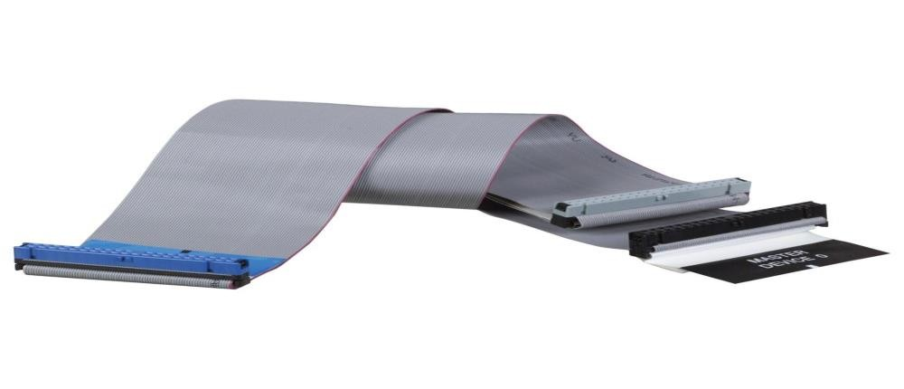
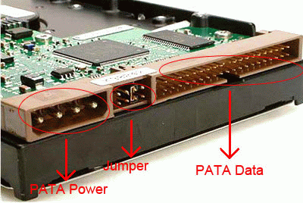
PATA (Parallel Advanced Technology Attachment)
It has a 40 pin connector.
Data transfer rate is 133mbps.
when installed this type of hard drives ensure that the jumpers are correctly configured.
If you have two devices connected to one IDE controller.
( one must be set to master and the other must be set to slave).
11

Slide 12

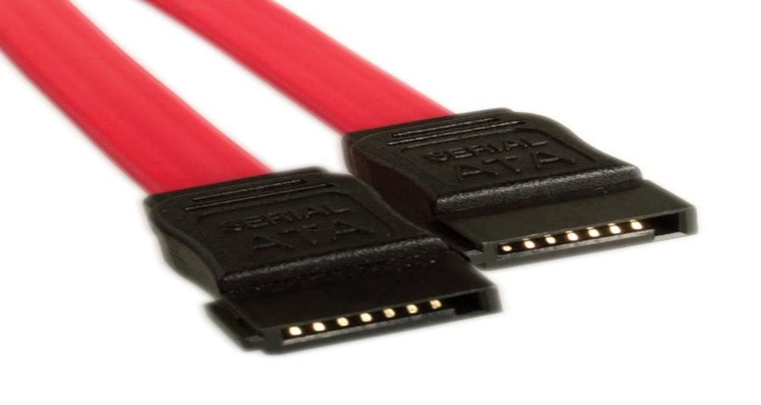
SATA (Serial Advanced Technology Attachment)
It has a 7pin connector.
It is the latest high-speed type of hard drive connectors.
Data transfer rate is 300mbps. As there are faster than old IDE interface.
the latest hard drives are using this type of interface.
As there are faster than old IDE interface.
12

Slide 13
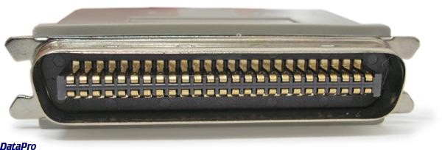
SCSI (Small Computer System Interface)
It has a 50 or 68 pin connector.
The data transfer rate is 600Mb/s .
These require a SCSI adapter card connected into the system.
Nowadays, most desktop computers did not use the SCSI.
13

Slide 14
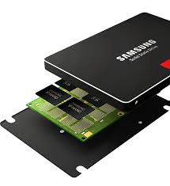
SSD(Solid State Drive)
A solid-state drive (SSD), or solid-state disk is a solid-state storage device that uses integrated circuit assemblies as memory to store data persistently.

Slide 15
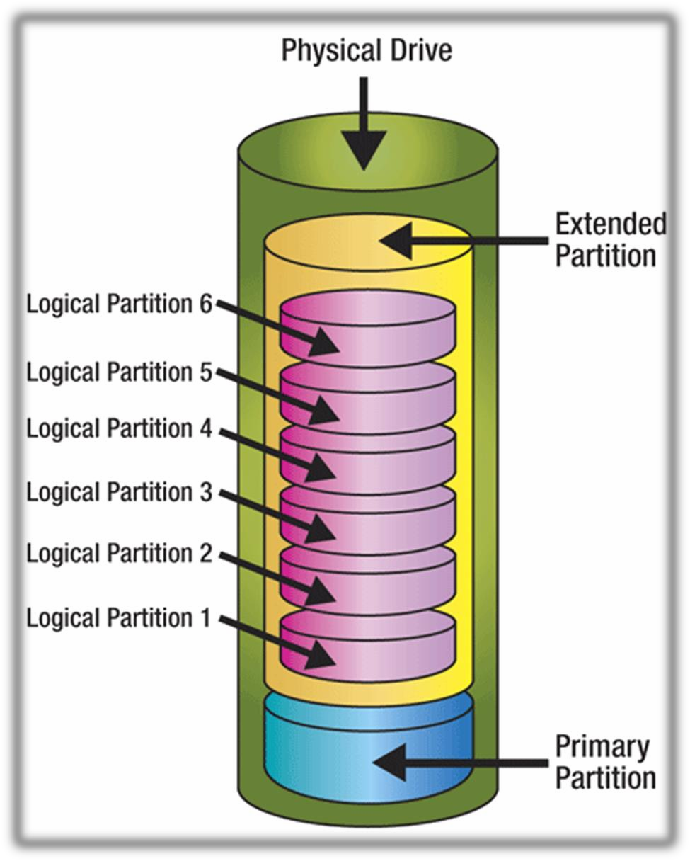
Disk Partitioning
15

Slide 16
Disk Formatting
The process of initializing these logical blocks on the physical disk platters is called low level formatting which is usually performed at the factory and is not normally changed in the field.
High level formatting then writes the file system structures into selected logical blocks to make the remaining logical blocks available to the host OS and its applications.
16

Slide 17
Performance characteristics
Latency
Latency is the delay for the rotation of the disk to bring the required disk sector under the read-write mechanism. It depends on rotational speed of a disk, measured in revolutions per minute (rpm).
Average rotational latency is shown in the table below, based on the statistical relation that the average latency in milliseconds for such a drive is one-half the rotational period.
Data transfer rate
Rotational speed [rpm] | Average latency [ms]
15,000 | 2
10,000 | 3
7,200 | 4.16
5,400 | 5.55
4,800 | 6.25
17

